Slide 1







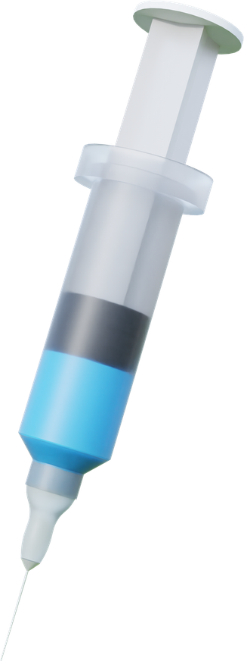
Team Name: CMStalin
Project Name: EWS(Early Warning System)
“Commanding Data, Safeguarding Lives”
Presentation By:
Rohit shyam Reddy (1DS24EE076)
Sindhu S K (1DS24EE094)
Sushan Shetty (1DS24EE101)
William Carey(1DS24EE114)

Slide 2
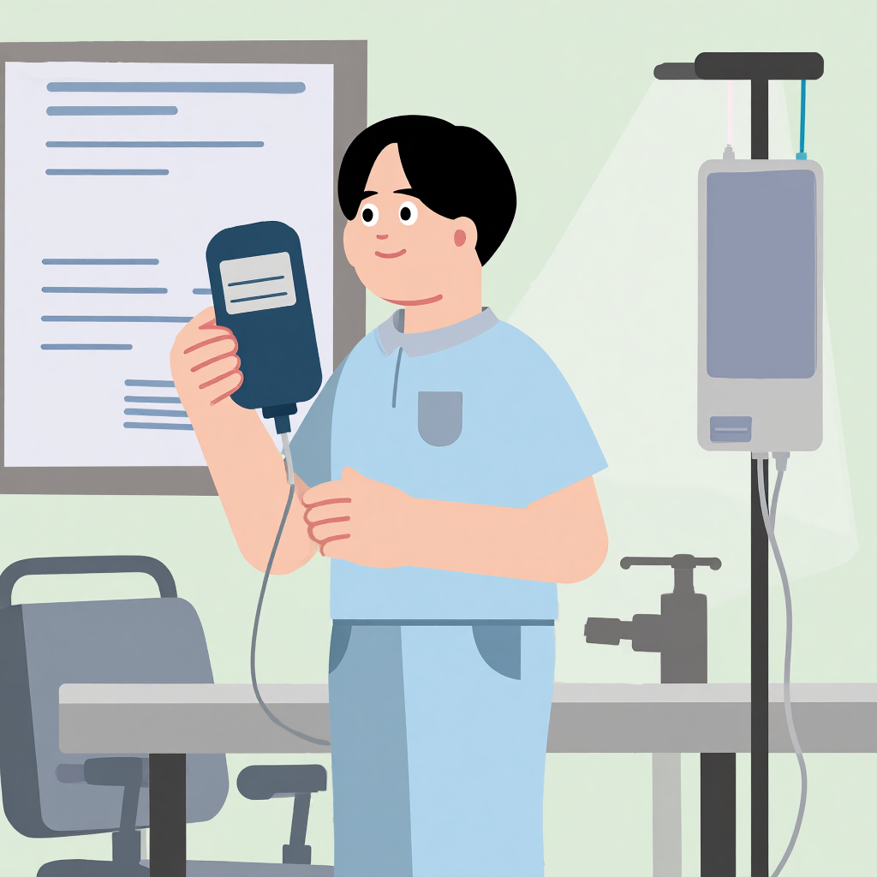
Problem Statement
​The Problem: Current health monitors are "reactive." They beep only after a patient’s vitals cross a dangerous threshold.
Who is facing it: ICU nurses, emergency responders, and home-care patients.
​Why it matters: In critical care, every second counts. Waiting for a "crash" before acting leads to preventable complications.

Slide 3
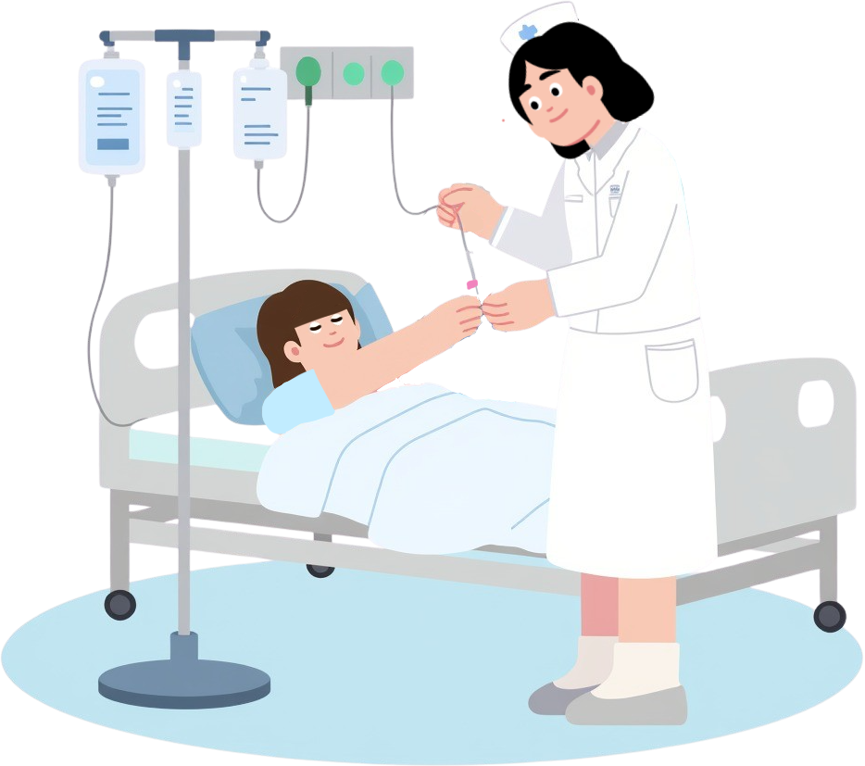
Solution Overview
What we are building: A smart AI monitor that tracks the velocity of vital signs.
The Solution: Instead of waiting for a heart rate to hit 120, our EWS detects that it is rising rapidly while SpO₂ is falling.
Key Idea: We move the "Alarm" forward in time, giving doctors minutes or hours of head-start to intervene.
Saving Lives is Our Commitment.

Slide 4

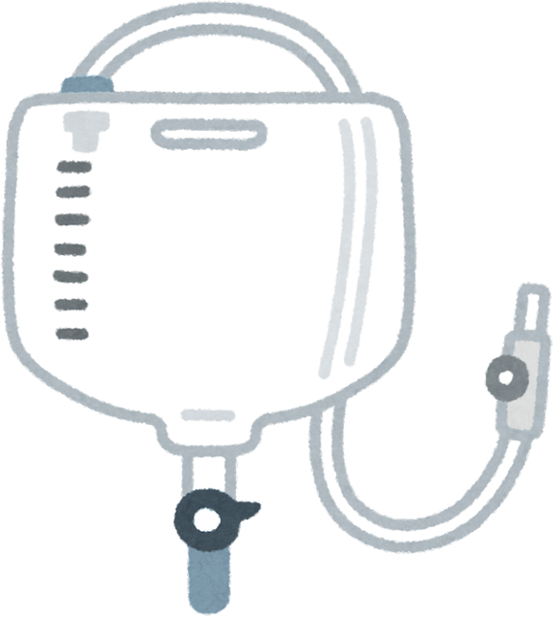
Tech Stack & Architecture
Integrated Care, Better Outcomes.
Front-End: Node.JS
Brain : Python

Slide 5

Features & Demo-Flow
Key Features:
Slope-Based Alerting: Mathematical detection of "Rising" vs "Stable" vitals.
Cardiopulmonary Correlation: Flags the dangerous "X-pattern" (HR up, SpO₂ down).
Human-Readable Insights: Explains exactly why a risk level was assigned.
Demo Flow:
Step 1: Load patient vitals (CSV or Manual).
Step 2: AI engine processes the last 6-12 readings.
Step 3: System outputs a color-coded Risk Level and Trend Analysis.

Slide 6
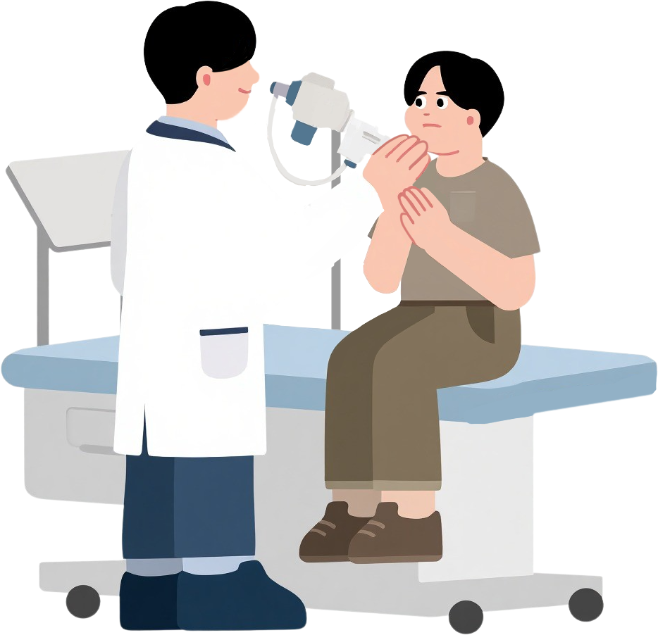
Impact & Market Value
Users: Small clinics, nursing homes, and "Hospital-at-Home" setups.
Value: It democratizes high-end ICU trend analysis for affordable devices.
Scalability: Can easily scale to monitor thousands of patients via a central dashboard.
Innovation Saves Time and Lives.

Slide 7
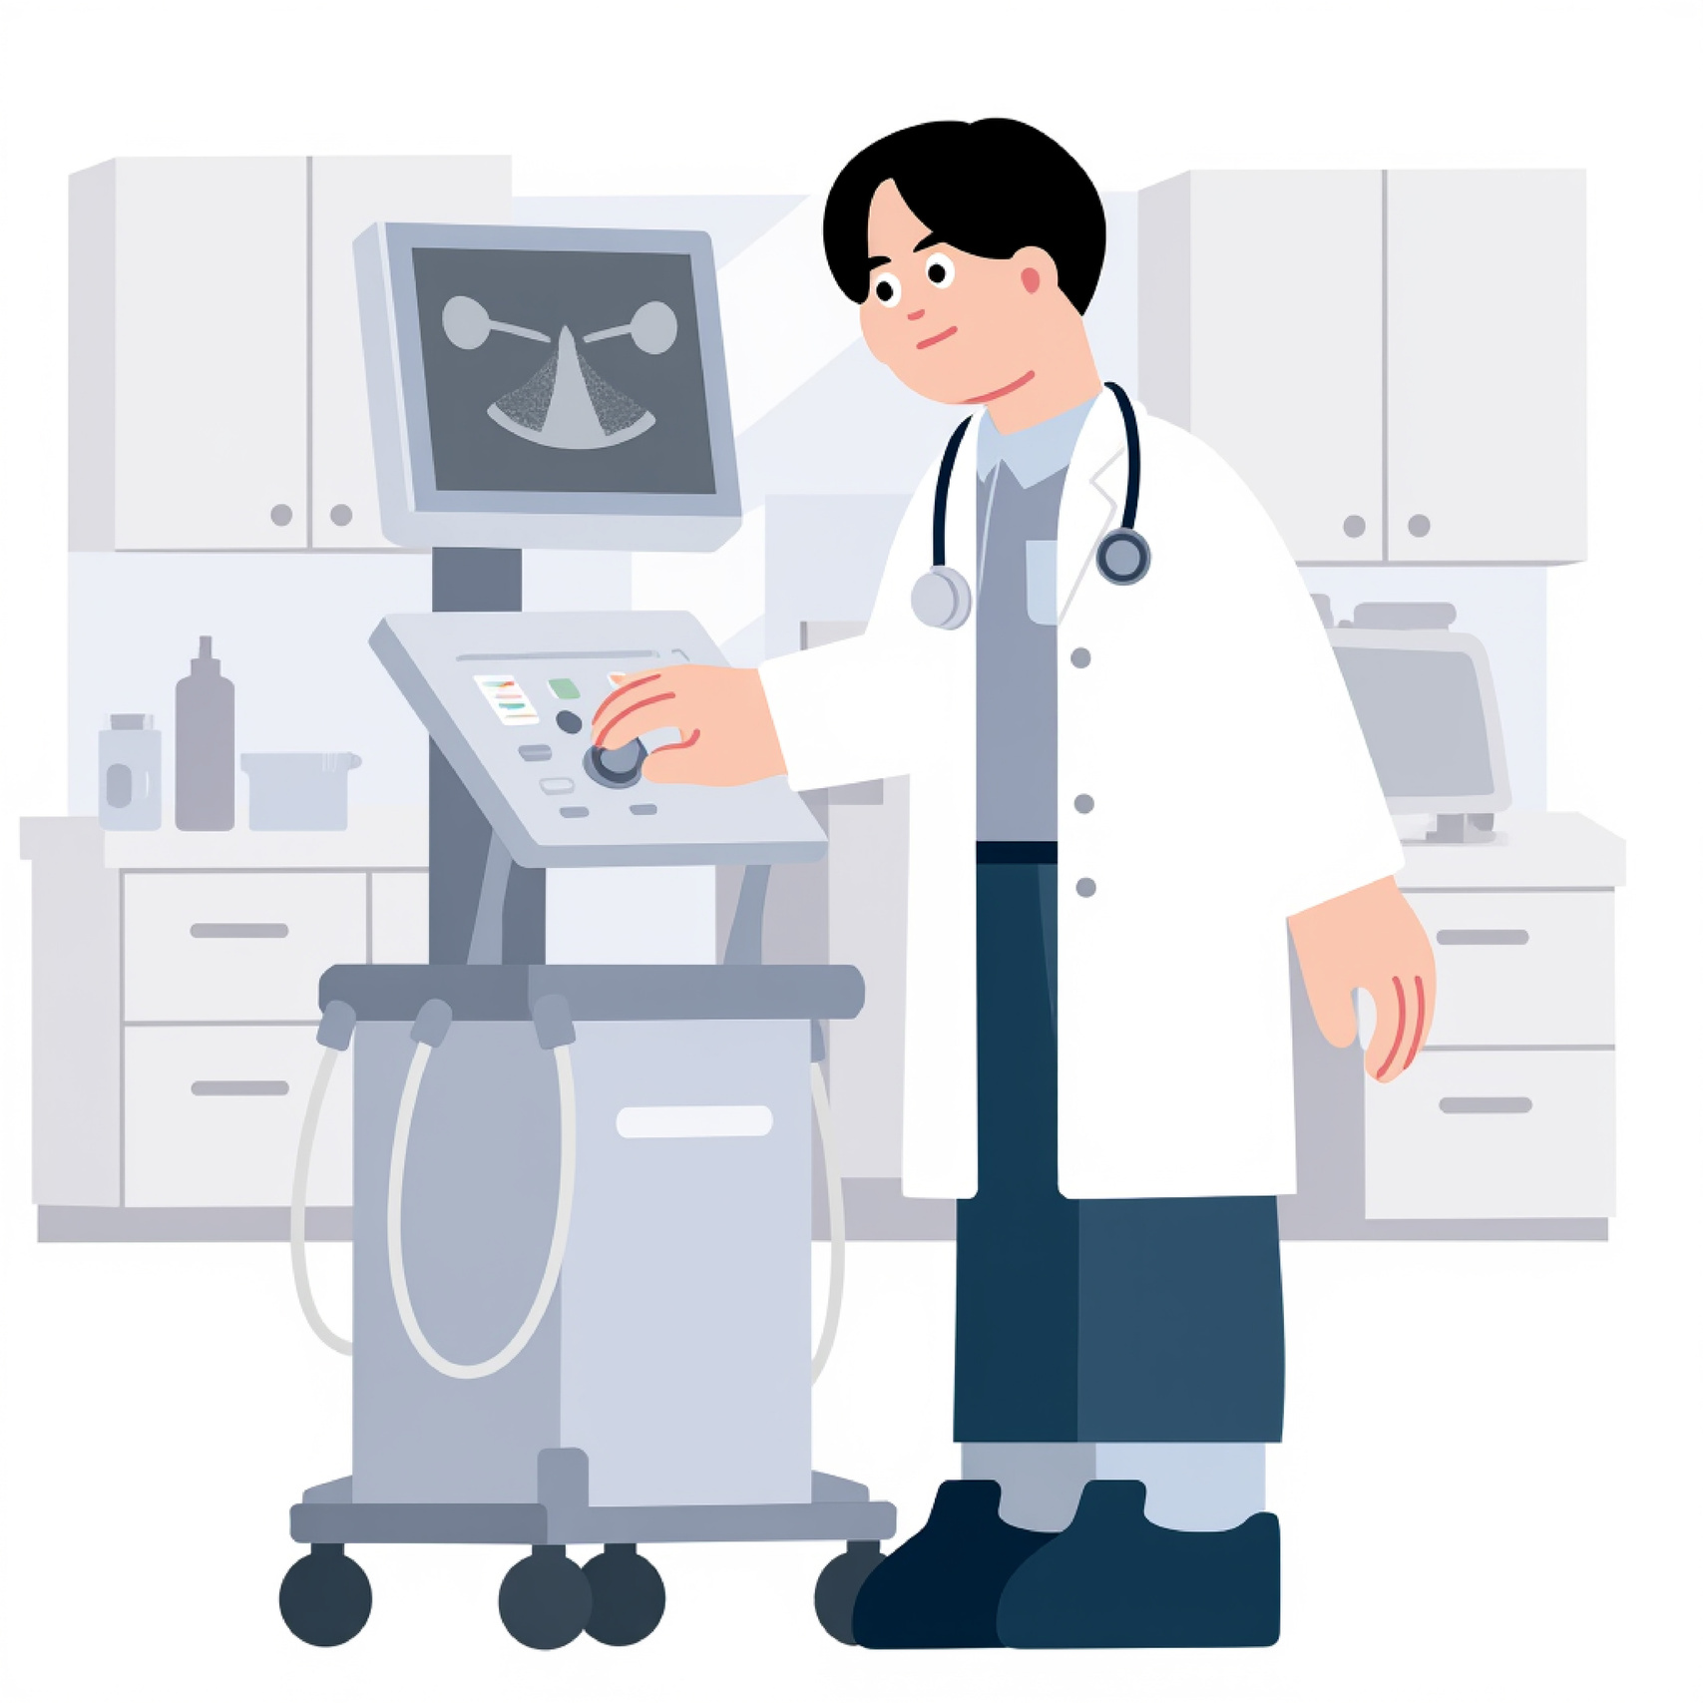
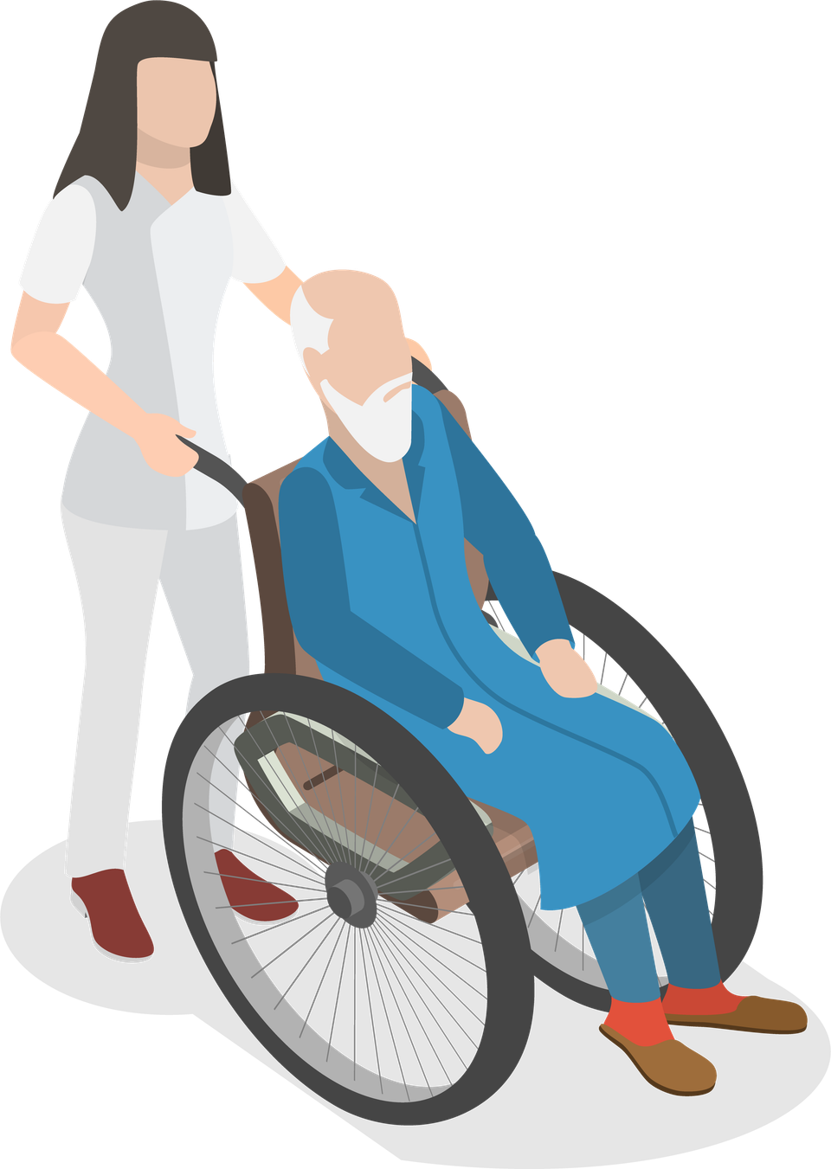


Challenges & Future-Scope
Integrated Care, Better Outcomes.
Challenges: Distinguishing between physical activity (normal HR rise) and clinical distress (abnormal HR rise).
Future Scope:
​1. Real-time API integration with wearable sensors (Pulse Oximeters).
2. Predictive SMS alerts to emergency contacts.

Slide 8
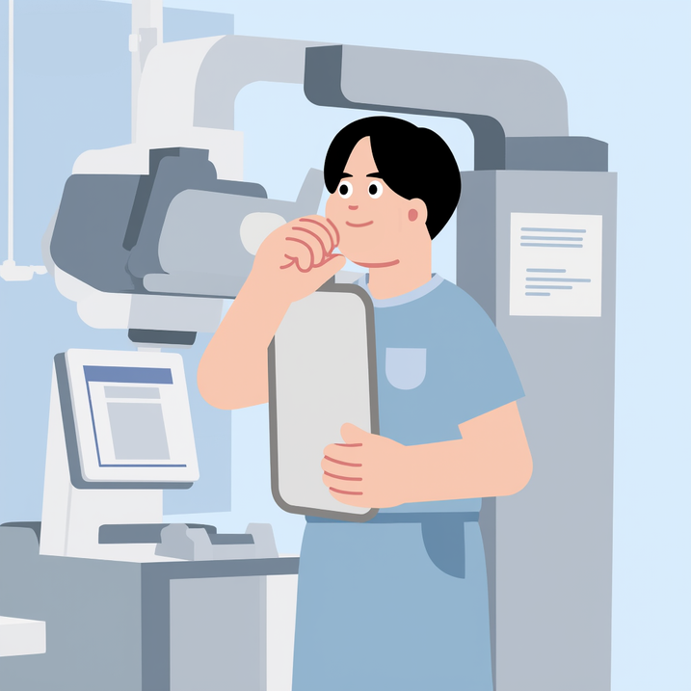
Uniqueness & Novelty
Commitment to Professional Excellence
The Difference: Most EWS solutions are hardware-locked and expensive. Our software-first approach works on any browser.
Novelty: We use Linear Regression slopes as a primary metric, which is far more accurate than standard "Min/Max" alarms.
Impact: We are providing "ICU-level intelligence" at zero hardware cost.

Slide 9


Conclusion
We’ve built EWS to ensure that no patient's deterioration goes unnoticed. We're turning "noise" into "notice."
Thank you for your time and for the opportunity!

Slide 10


Thank You
Better Healthcare, Brighter Tomorrow.

